Slide 1
Pollard P-1 factoring

Slide 2
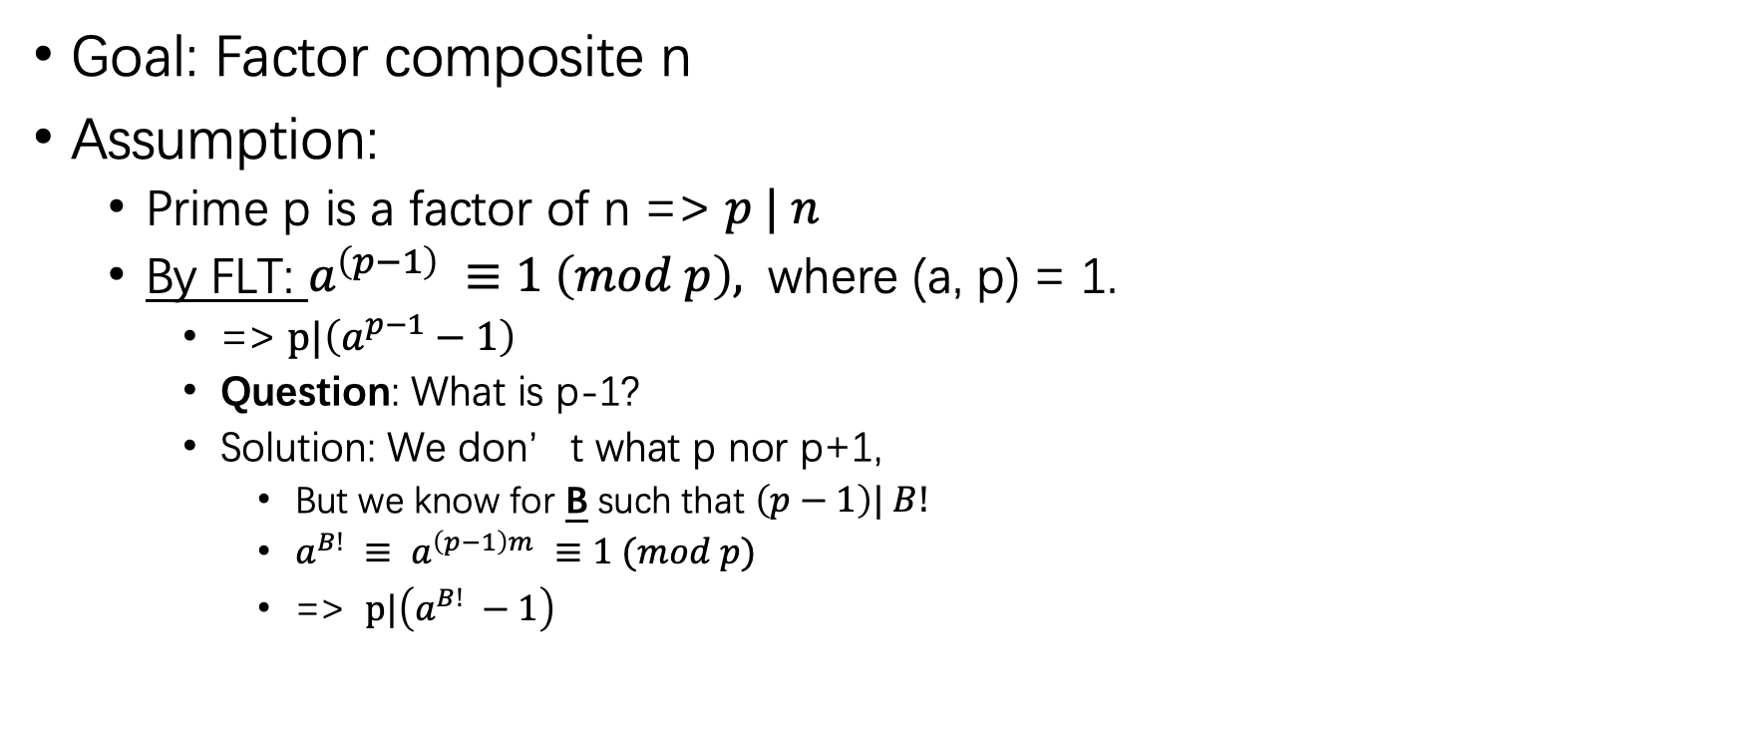
Set up
Goal: Factor composite n
Assumption:
Prime p is a factor of n => $p | n$
By FLT: $a^{\left(p−1\right)} ≡1 \left(mod p\right),$ where (a, p) = 1.
=> $p|\left(a^{p−1}−1\right)$
Question: What is p-1?
Solution: We don’t what p nor p+1,
But we know for B such that $\left(p−1\right)| B!$
$a^{B!} ≡ a^{\left(p−1\right)m} ≡1 (mod p)$
=> $p|\left(a^{B!} −1\right)$

Slide 3
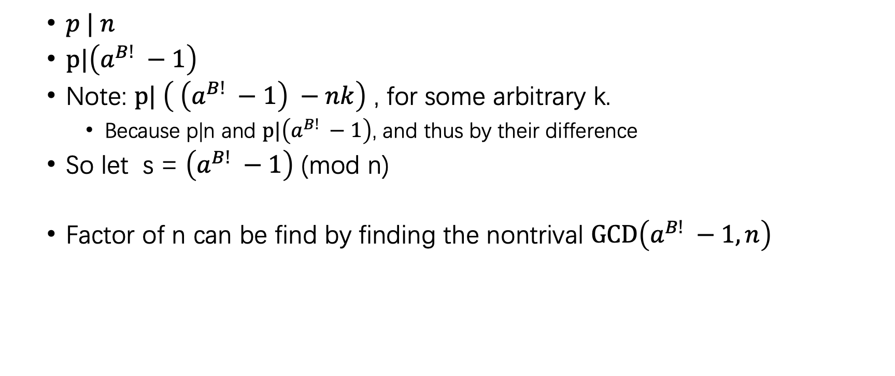
Continue
$p | n$
$p|\left(a^{B!} −1\right)$
Note: $p| \left( \left(a^{B!} −1\right) −nk\right)$ , for some arbitrary k.
Because p|n and $p|\left(a^{B!} −1\right)$, and thus by their difference
So let s = $\left(a^{B!} −1\right)$ (mod n)
Factor of n can be find by finding the nontrival $GCD\left(a^{B!} −1, n\right)$

Slide 4
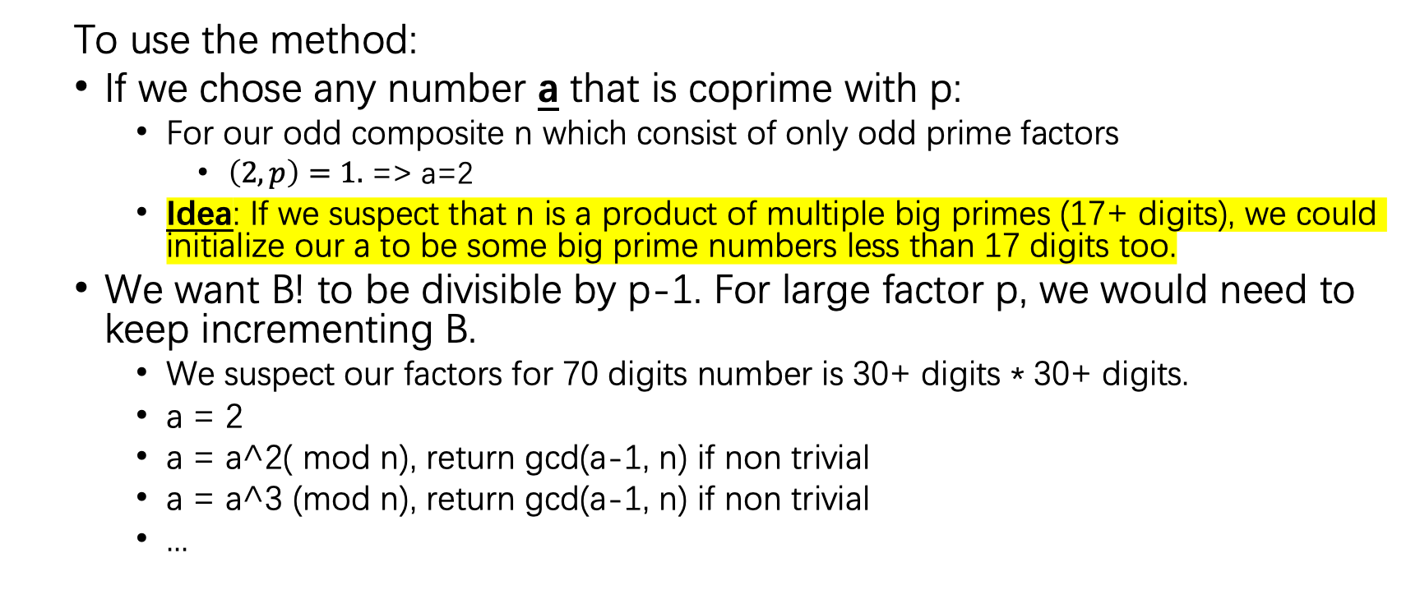
Algorithm
To use the method:
If we chose any number a that is coprime with p:
For our odd composite n which consist of only odd prime factors
$\left(2, p\right)=1.$ => a=2
Idea: If we suspect that n is a product of multiple big primes (17+ digits), we could initialize our a to be some big prime numbers less than 17 digits too.
We want B! to be divisible by p-1. For large factor p, we would need to keep incrementing B.
We suspect our factors for 70 digits number is 30+ digits * 30+ digits.
a = 2
a = a^2( mod n), return gcd(a-1, n) if non trivial
a = a^3 (mod n), return gcd(a-1, n) if non trivial
...

